Slide 1

Youth blog
Presented by : Kunalgurav

Slide 2
Blog of Youth
The purpose of creating youths carrier website is to guide youths in their Careers platform. In modern time social media is big platform where million of youth joined and search daily for their Careers related questions. Mostly are unable to find out proper resolution. For those we make a website where youth come and get theirs answer and also can express their view on career platform .We create this website for youth they can get easily their solution and post their blog on Youth Blog website ,So our motto is encouraging them with constructive motivation can extend hope and could illuminate their future outlook towards the world. So lastly said that “Without Motivation, there is No Ambition.” We include many features such as ..

Slide 3
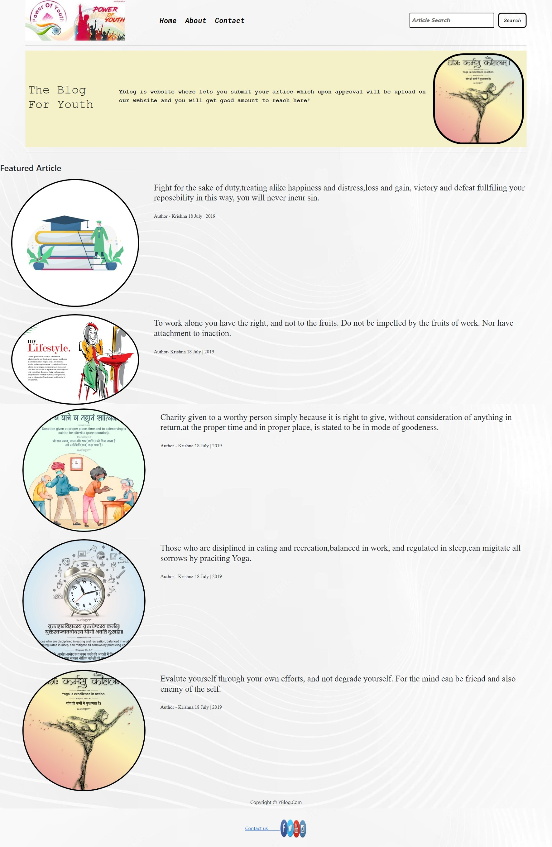
Home

Slide 4
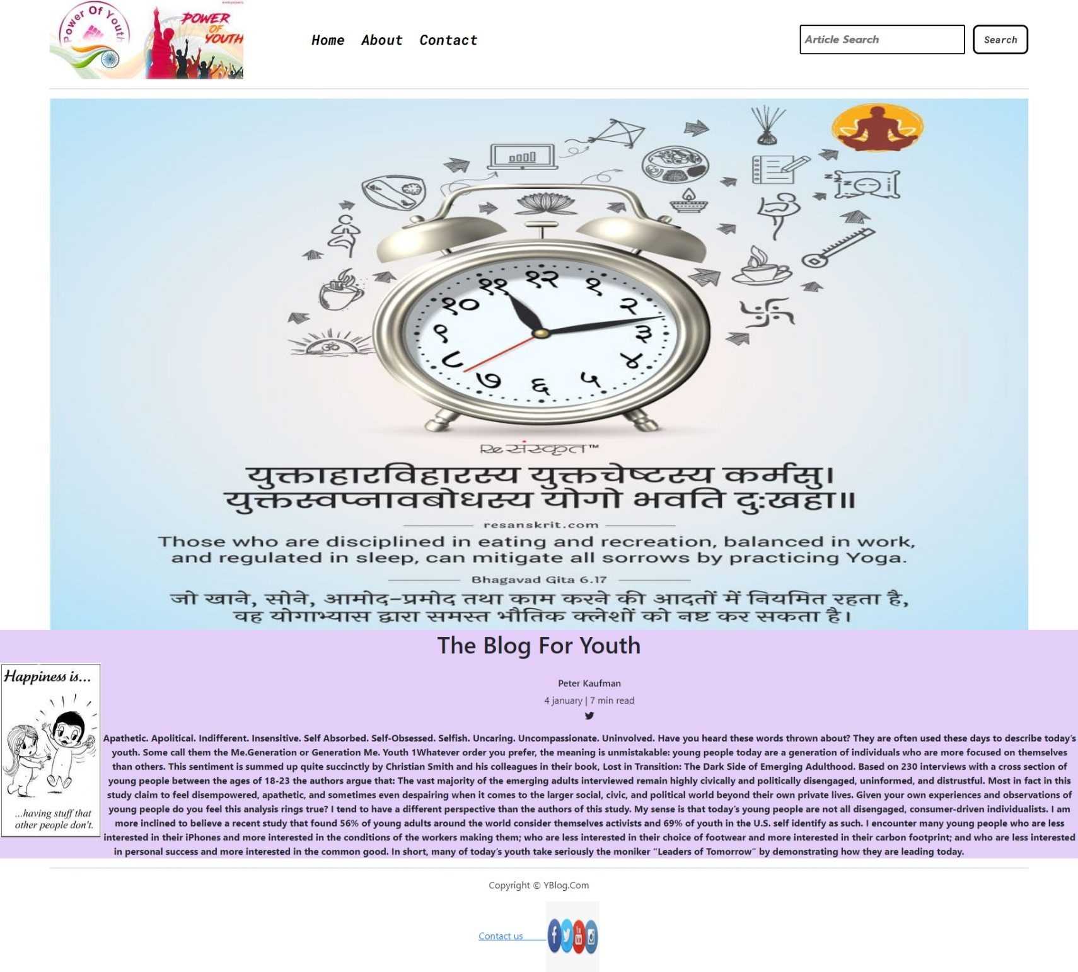
About us

Slide 5
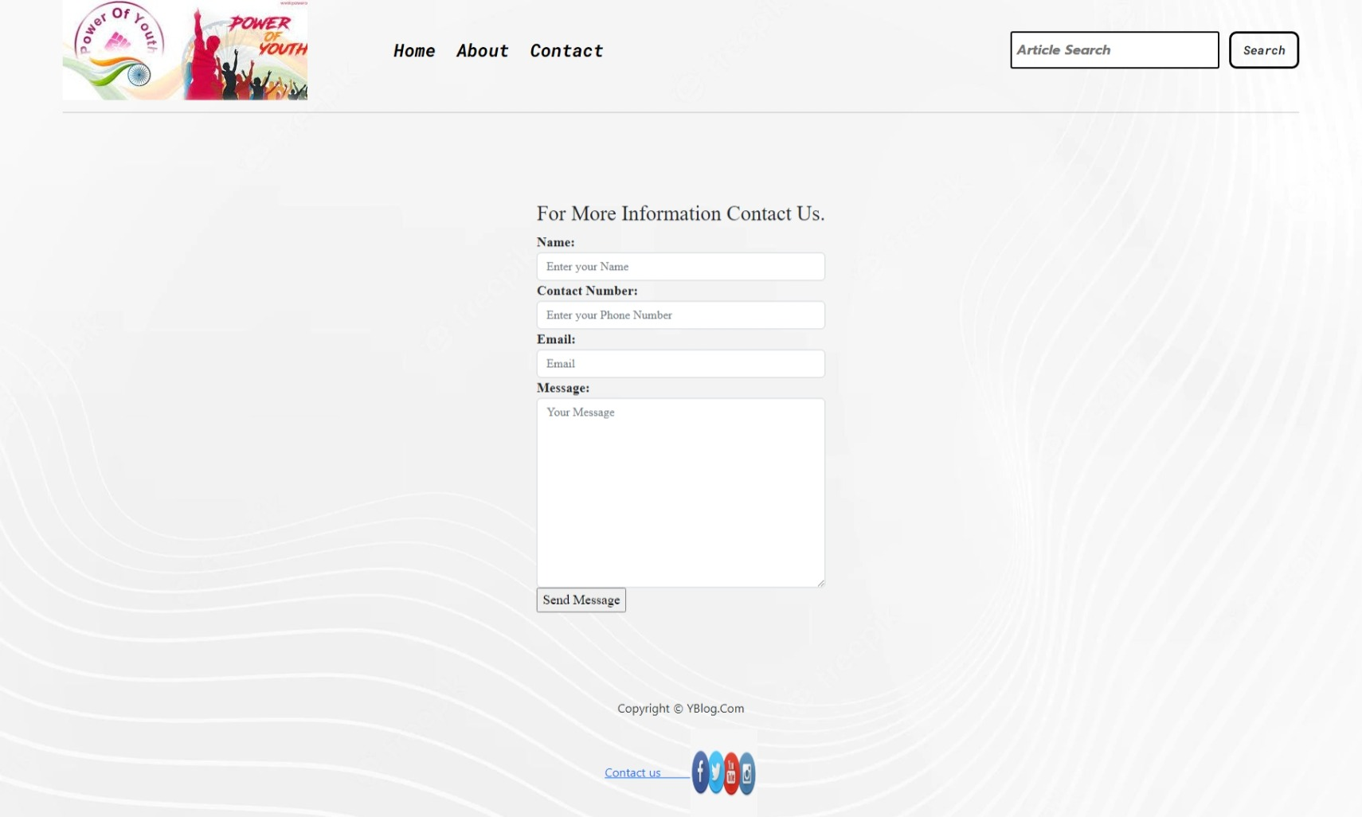
Contact us

Slide 6
Thank you

